Slide 1
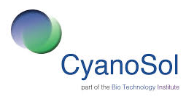
Scale-up of a photocatalytic treatment unit for degradation of biocidal agents at source
Indira Menezes
a
Email: i.de-menezes-castro@rgu.ac.uk
Robert Gordon University
Supervisory team: Dr Carlos Pestana, Professor Linda Lawton and Dr Bruce Petrie

Slide 2
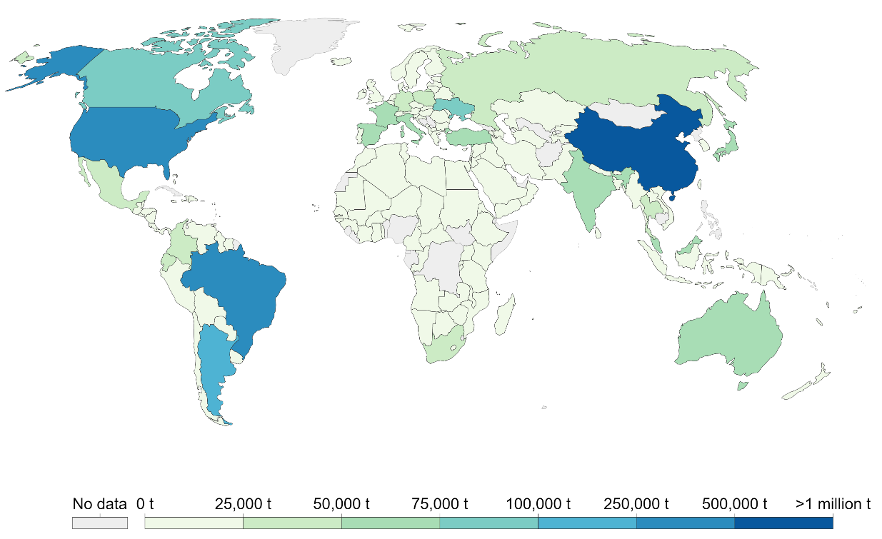
ENVIRONMENTAL OVERVIEW
Total annual pesticide usage (tonnes) of pesticide during 2017
(UN Food and Agricultural Organization, 2017).

Slide 3
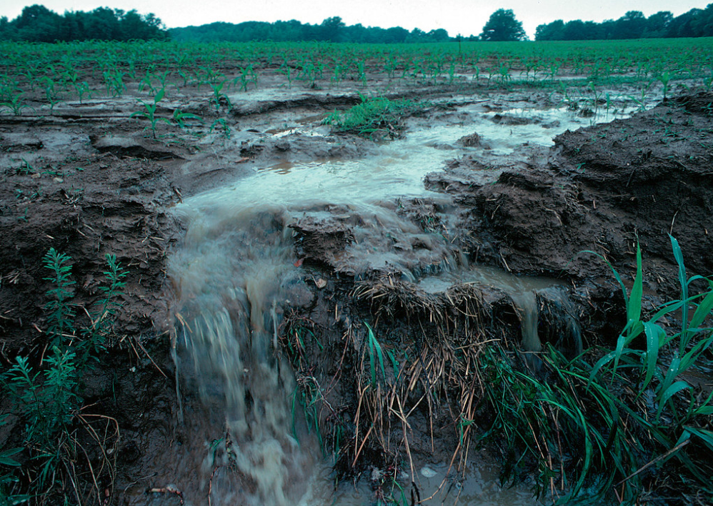
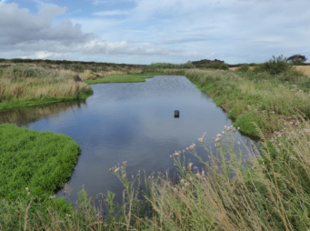
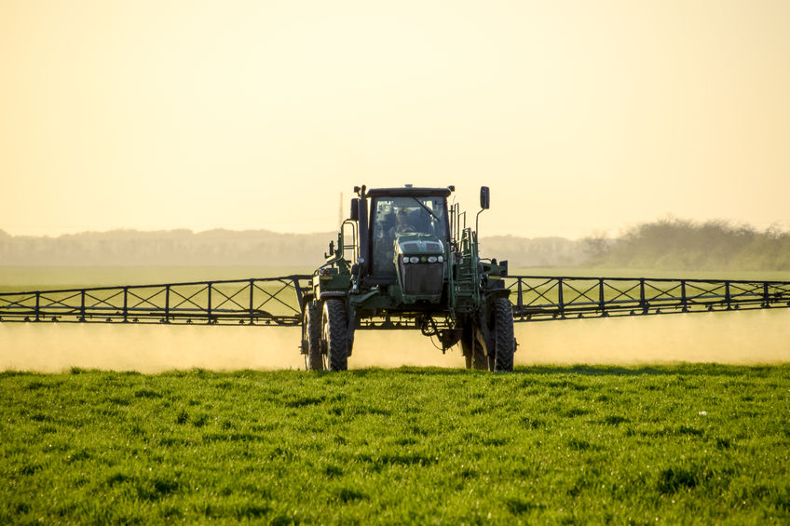
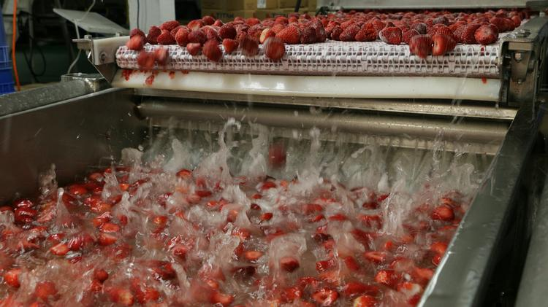
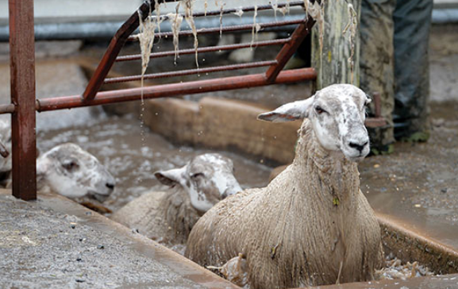
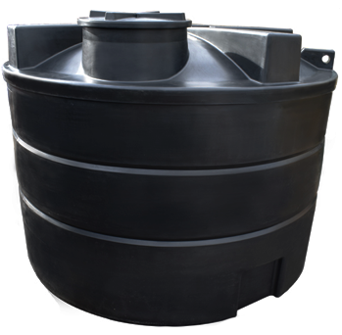
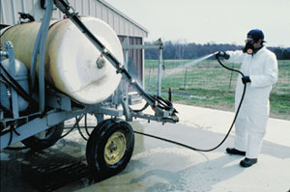
ENVIRONMENTAL OVERVIEW
Pond
Wastewater storage tank
Application of pesticides

Slide 4
ENVIRONMENTAL OVERVIEW
Agricultural use of pesticides
Wastewater discharge from farms
Release in aquatic environments
Harmful
effects
Application of new technologies to treat pesticides
at source

Slide 5
ENVIRONMENTAL OVERVIEW
PHOTOCATALYSIS AS AN ADVANCED OXIDATION PROCESS
Chemical radical
Organic pollutant
Light energy
Conduction Band
hv > Band gap
-
e
Band Gap
+
h
Chemical radical
H₂O + CO₂
Valence Band

Slide 6
AIM AND OBJECTIVES
Develop a novel and economical treatment unit based on
photocatalysis that can be applied at source for pesticide removal
from wastewater in farms across Scotland
to develop and build a photocatalytic treatment unit that will allow removal of pesticides at source;
to perform bench-scale experiments using different catalysts and light sources in order to optimize the photocatalytic treatment at source;
to deploy and evaluate photocatalytic reactors in farms across Scotland and refine its design to extend its use.

Slide 7
PHOTOCATALYTIC TREATMENT UNIT
CATALYST
LIGHT
SOURCE
MATERIALS
FORMAT AND
DIMENSIONS

Slide 8
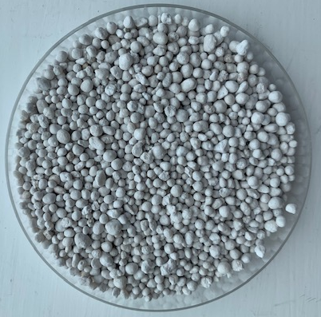
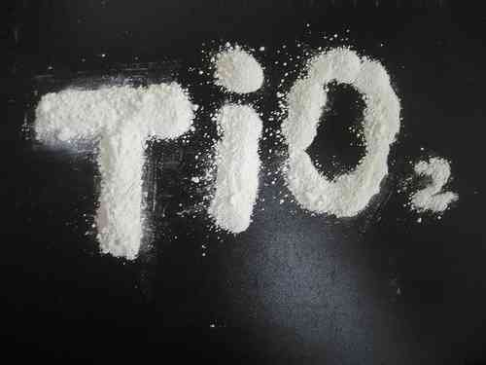
CATALYST
MATERIALS
Uncoated beads
Powdered TiO₂
TiO₂ coated beads

Slide 9
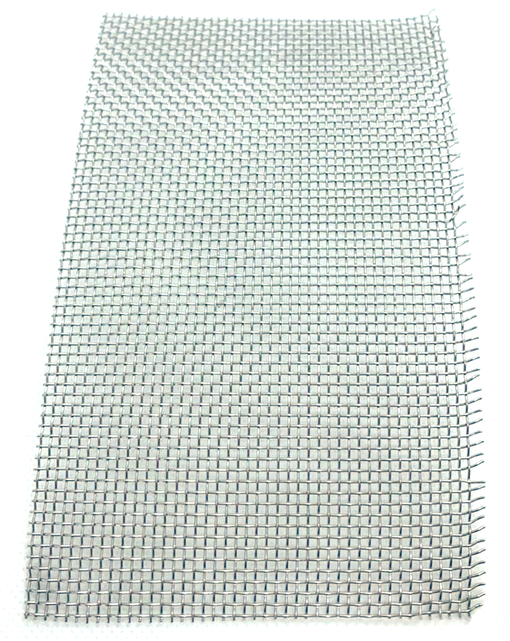
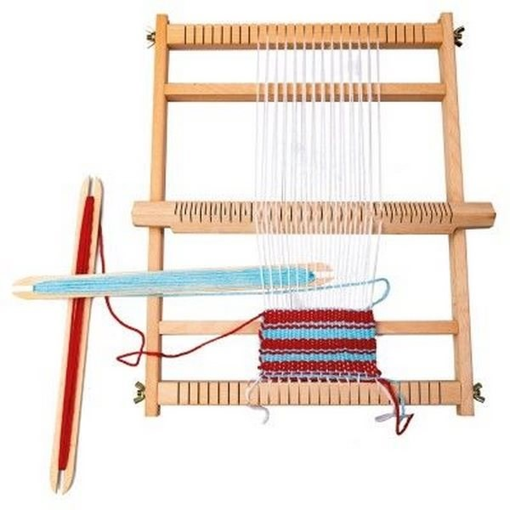
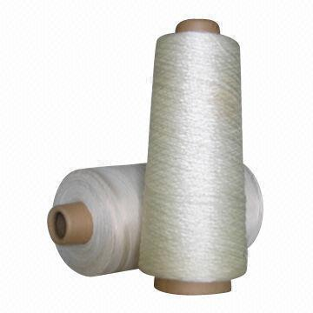
MATERIALS
Glass fibre thread and weaving loom
Glass fibre mesh
Stainless-steel mesh

Slide 10
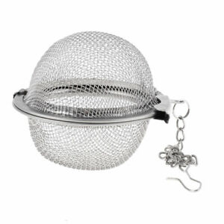
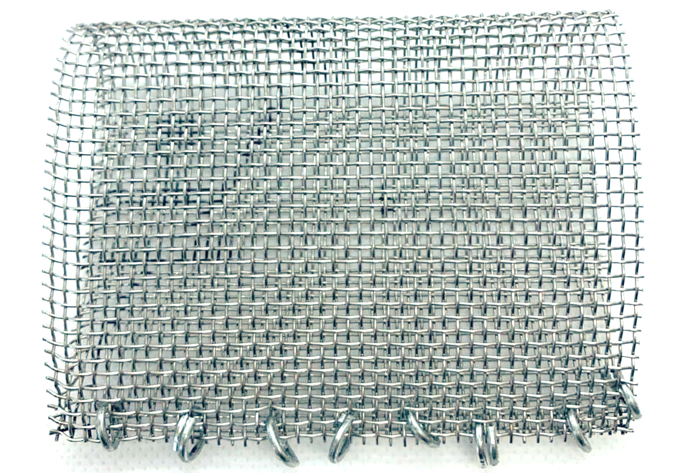
FORMAT AND DIMENSIONS
PODS TO CONTAIN THE CATALYST
Stainless-steel tea pods
Metal rings
Stainless-steel pod

Slide 11
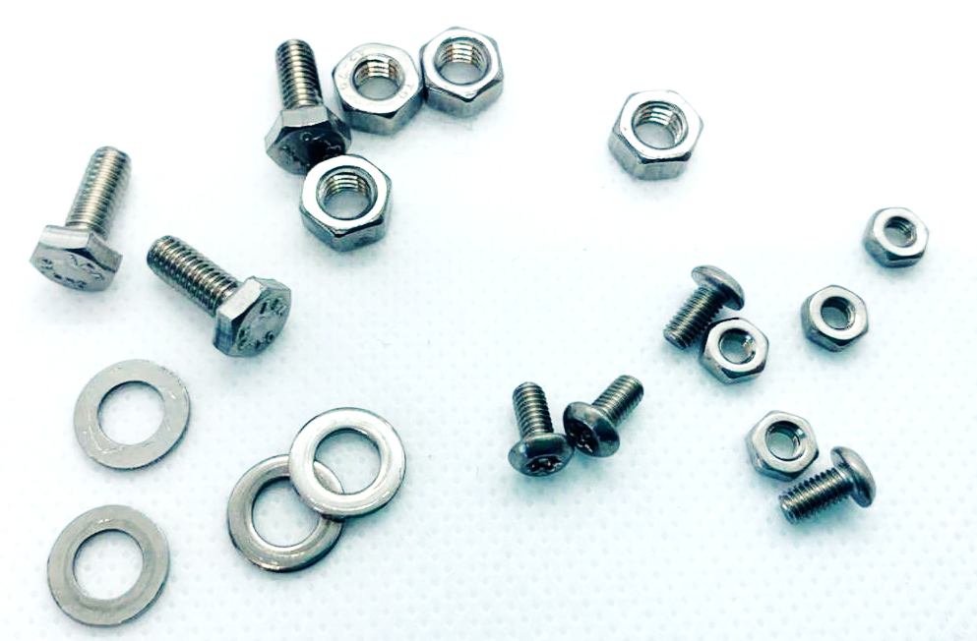
FORMAT AND DIMENSIONS
TREATMENT UNIT
1 metre
Cylindrical treatment unit
Stainless-steel nuts, screws and washers

Slide 12
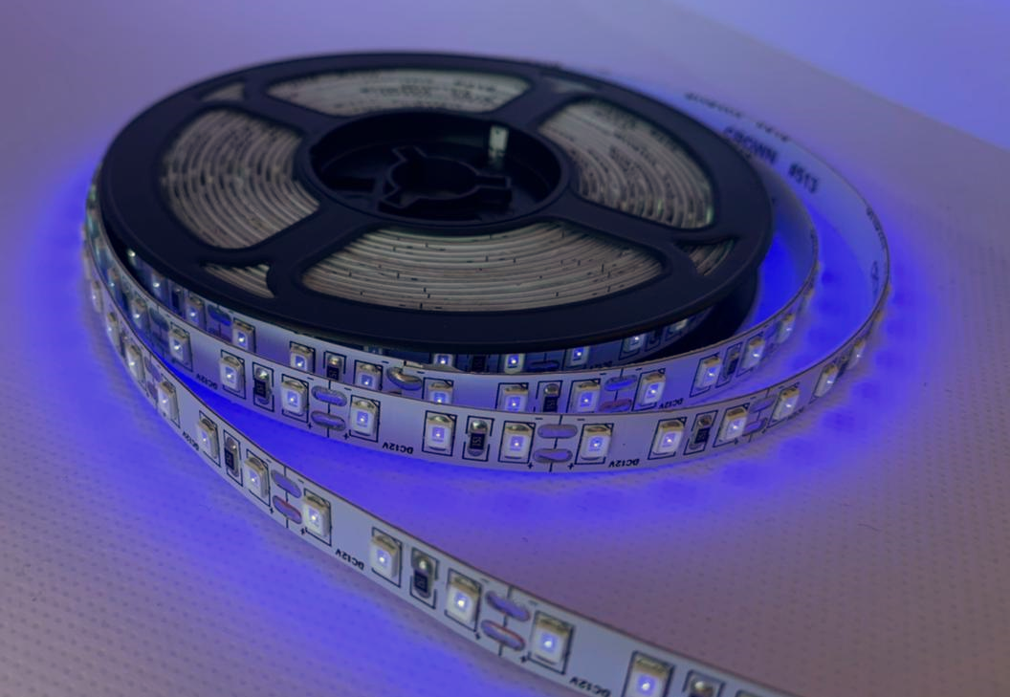
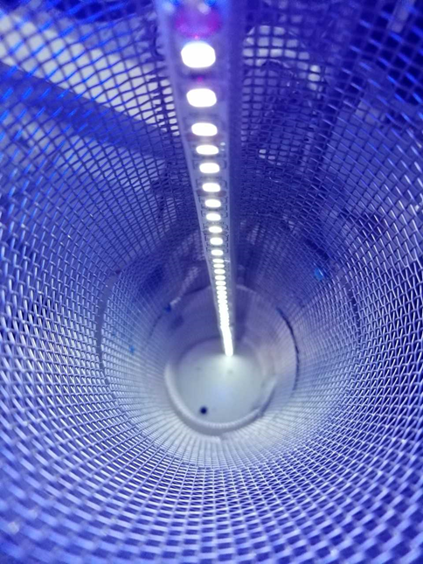
LIGHT SOURCE
Non waterproof UV-LEDs
Waterproof UV-LEDs
Prototype used in a pilot-scale study

Slide 13
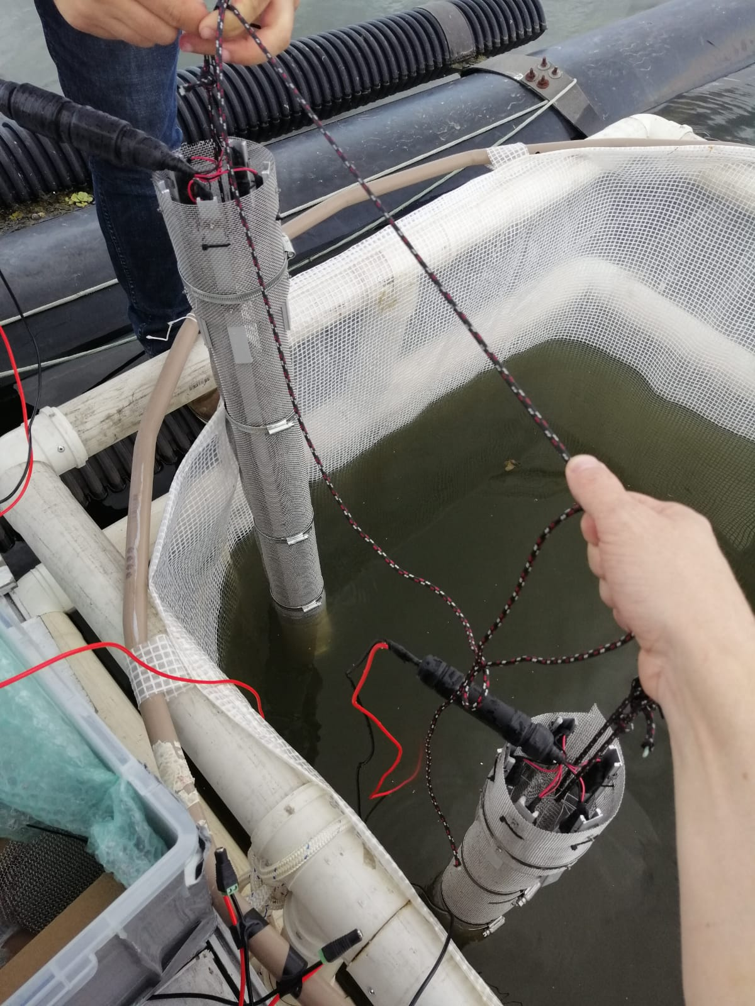
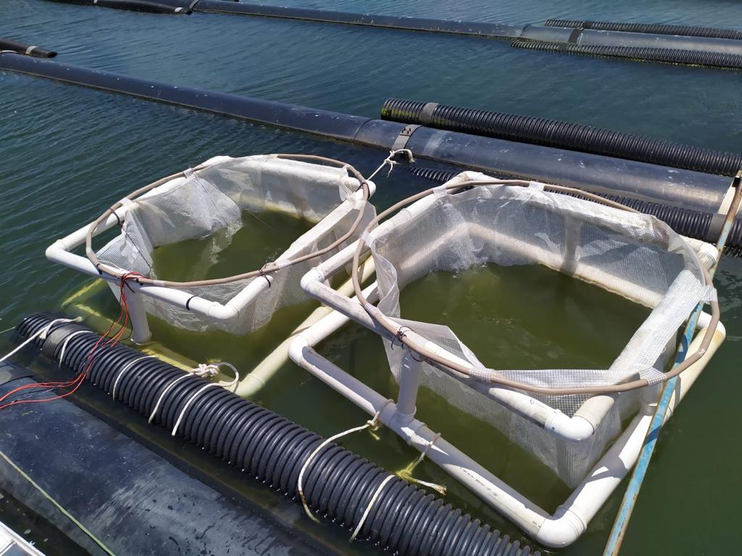
Photocatalytical Degradation of Cyanotoxins in a Reservoir in Brazil

Slide 14
NEXT CHALLENGES AND SOME IDEAS
Wire connectors
Wire seal
Non waterproof UV-LEDs inside acrylic tubes

Slide 15
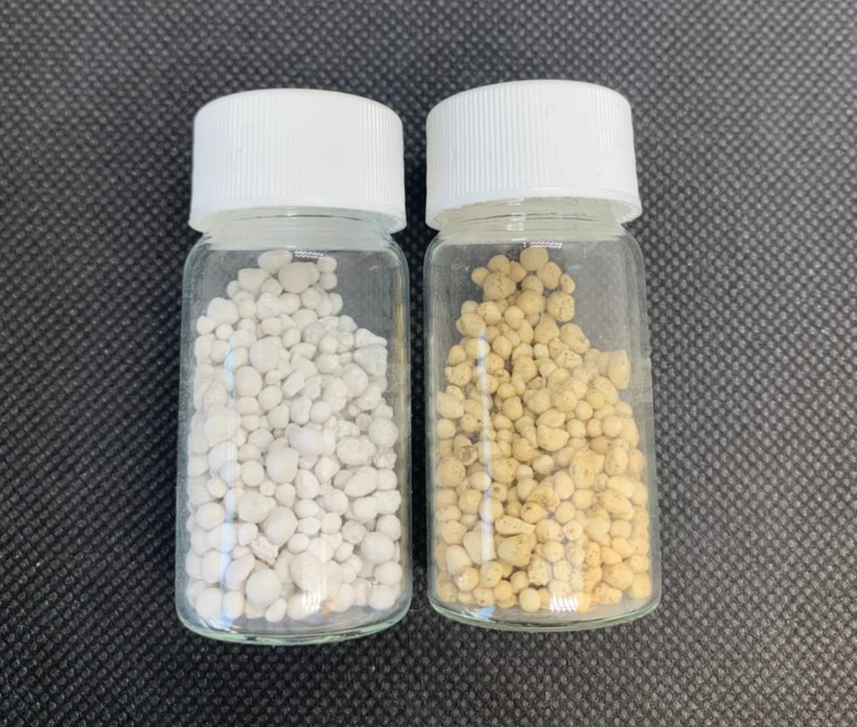
NEXT CHALLENGES AND SOME IDEAS
TiO₂ and C₃N₄ coated beads

Slide 16
Thank you!
Any questions?

